Slide 1
MGMT 58600: Python Programming
Lecture 7
Dr. Shoaib Khan

Slide 2
NumPy
NumPy is the fundamental package for scientific computing in Python
It is a Python library that provides a multidimensional array object and various derived objects (such as masked arrays and matrices)
Provides fast operations on arrays, including:
Mathematical and logical,
shape manipulation,
sorting,
selecting,
discrete Fourier transforms,
basic linear algebra,
basic statistical operations,
random simulation and much more.

Slide 3
Numpy: Installation and First Program
NumPy can be installed via the following pip command:
pip install numpy
NumPy is used to work with arrays. The array object in NumPy is called ndarray.
We can create a NumPy ndarray object by using the array() method.
import numpy as np arr = np.array([1, 2, 3, 4, 5]) print(arr) print(type(arr))
To create an ndarray, we can pass a list, tuple or any array-like object into the array() method, and it will be converted into an ndarray:
import numpy as np arr = np.array((1, 2, 3, 4, 5)) print(arr)

Slide 4
Dimensions in Arrays
A dimension in arrays is one level of array depth (nested arrays).
0-D arrays, or Scalars, are the elements in an array. Each value in an array is a 0-D array.
An array that has 0-D arrays as its elements is called uni-dimensional or 1-D array.
An array that has 1-D arrays as its elements is called a 2-D array. These are often used to represent matrix or 2nd order tensors.
arr = np.array([[1, 2, 3], [4, 5, 6]]) print(arr)
An array that has 2-D arrays (matrices) as its elements is called 3-D array. These are often used to represent a 3rd order tensor.
arr = np.array([[[1, 2, 3], [4, 5, 6]], [[1, 2, 3], [4, 5, 6]]]) print(arr)
NumPy Arrays provides the ndim attribute that returns an integer that tells us how many dimensions the array have.

Slide 5
Why Use NumPy?
In Python we have lists that serve the purpose of arrays, but they are slow to process
NumPy aims to provide an array object that is up to 50x faster than traditional Python lists
NumPy arrays are stored at one continuous place in memory unlike lists, so processes can access and manipulate them very efficiently
NumPy arrays provide a lot of supporting functions (e.g., vectorized operations) which offers added convenience
Arrays are very frequently used in data science, where speed and resources are very important
Let’s see the performance difference in action!

Slide 6
Dimensions in NumPy Arrays
A dimension in arrays is one level of array depth (nested arrays).
0-D arrays, or Scalars, are the elements in an array. Each value in an array is a 0-D array.
An array that has 0-D arrays as its elements is called uni-dimensional or 1-D array.
An array that has 1-D arrays as its elements is called a 2-D array. These are often used to represent matrix or 2nd order tensors.
arr = np.array([[1, 2, 3], [4, 5, 6]]) print(arr)
An array that has 2-D arrays (matrices) as its elements is called 3-D array. These are often used to represent a 3rd order tensor.
arr = np.array([[[1, 2, 3], [4, 5, 6]], [[1, 2, 3], [4, 5, 6]]]) print(arr)

Slide 7
Dimensions in NumPy Arrays
NumPy Array has the ndim attribute that returns an integer telling us how many dimensions the array has.
a = np.array(42) b = np.array([1, 2, 3, 4, 5]) c = np.array([[1, 2, 3], [4, 5, 6]]) d = np.array([[[1, 2, 3], [4, 5, 6]], [[1, 2, 3], [4, 5, 6]]]) print(a.ndim) print(b.ndim) print(c.ndim) print(d.ndim)
An array can have any number of dimensions. When the array is created, you can define the number of dimensions by using the ndmin argument.
arr = np.array([1, 2, 3, 4], ndmin=5) print(arr) print('number of dimensions :', arr.ndim)

Slide 8
Access Array Elements
You can access an array element by referring to its index number.
arr = np.array([1, 2, 3, 4]) print(arr[0])
print(arr[2] + arr[3])
For 2-D arrays:
arr = np.array([[1,2,3,4,5], [6,7,8,9,10]]) print('2nd element on 1st row: ', arr[0, 1])
print('5th element on 2nd row: ', arr[1, 4])
For 3-D arrays:
arr = np.array([[[1, 2, 3], [4, 5, 6]], [[7, 8, 9], [10, 11, 12]]]) print(arr[0, 1, 2])
Same principle extends to higher dimensional arrays

Slide 9
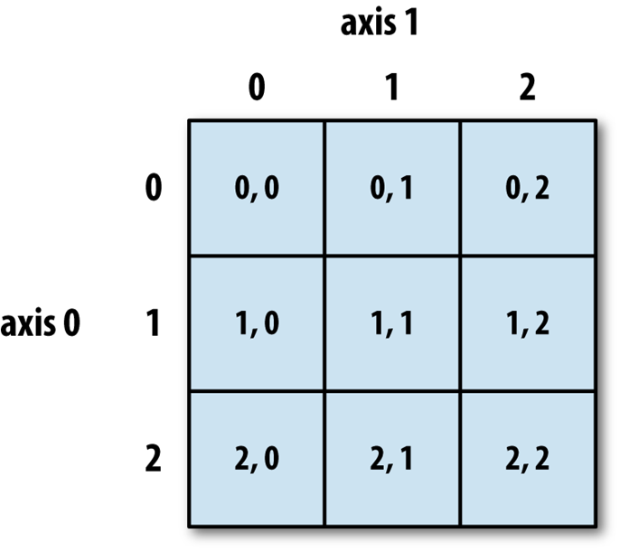
Accessing Array Elements in > 1 Dimensions
Figure illustrates indexing in a 2-D array
Negative Indexing:
arr = np.array([[1,2,3,4,5], [6,7,8,9,10]]) print('Last element from 2nd dim: ', arr[1, -1])
Slicing in Python means taking elements from one index to another. We slice arrays using start and end indices: [start:end]
We can also define the step (default = 1): [start:end:step]
arr = np.array([1, 2, 3, 4, 5, 6, 7]) print(arr[1:5])
print(arr[4:])
print(arr[:5])
print(arr[-3:-1])
print(arr[1:5:2])
print(arr[::2])

Slide 10
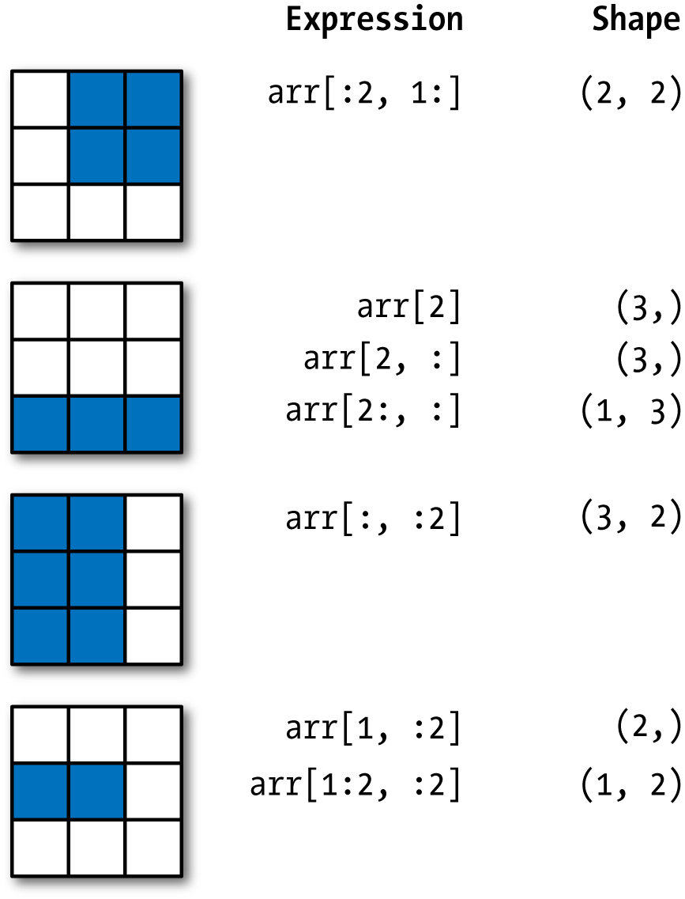
Slicing in Higher Dimensions
Slicing for more than 1 dimension:
arr = np.array([[1, 2, 3], [4, 5,6], [7, 8, 9]])
print(arr[:2, 1:])
print(arr[2])
print(arr[2,:])
print(arr[2:,:])
print(arr[1, :2])
print(arr[1:2, :2])

Slide 11
Data Types in NumPy
NumPy arrays are homogenous i.e., all elements are the same data type.
The data type or dtype is an attribute of ndarray used by Python to interpret a chunk of memory as a particular type of data:
arr1 = np.array([1, 2, 3], dtype=np.float64)
arr2 = np.array([1, 2, 3], dtype=np.int32)
arr1.dtype #dtype('float64')
arr2.dtype #dtype('int32’)

Slide 12
Type | Type code | Description
int8, uint8 | i1, u1 | Signed and unsigned 8-bit (1 byte) integer types
int16, uint16 | i2, u2 | Signed and unsigned 16-bit integer types
int32, uint32 | i4, u4 | Signed and unsigned 32-bit integer types
int64, uint64 | i8, u8 | Signed and unsigned 64-bit integer types
float16 | f2 | Half-precision floating point
float32 | f4 or f | Standard single-precision floating point; compatible with C float
float64 | f8 or d | Standard double-precision floating point; compatible with C double and Python float object
float128 | f16 or g | Extended-precision floating point
complex64, complex128, complex256 | c8, c16, c32 | Complex numbers represented by two 32, 64, or 128 floats, respectively
bool | ? | Boolean type storing True and False values
object | O | Python object type; a value can be any Python object
string_ | S | Fixed-length ASCII string type (1 byte per character); for example, to create a string dtype with length 10, use 'S10'
unicode_ | U | Fixed-length Unicode type (number of bytes platform specific); same specification semantics as string_ (e.g., 'U10')

Slide 13
More Ways to Create Arrays
In addition to np.array(), there are a number of other methods for creating new arrays.
arange() is an array-valued version of the built-in Python range function
np.arange(15)
zeros() and ones() create arrays of 0s or 1s, respectively, with a given length or shape.
np.zeros(10)
np.ones(10)
Empty() creates an array without initializing its values to any particular value.
np.empty((2, 3, 2))
To create a higher dimensional array with these methods, pass a tuple for the shape
np.zeros((3, 6))

Slide 14
Shape of Array
The shape of an array is the number of elements in each dimension.
NumPy arrays have an attribute called shape that returns a tuple with each index having the number of corresponding elements.
arr = np.array([[1, 2, 3, 4], [5, 6, 7, 8]]) print(arr.shape)
arr = np.array([1, 2, 3, 4], ndmin=5) print(arr) print('shape of array :', arr.shape)
By reshaping we can add or remove dimensions or change number of elements in each dimension.
arr = np.array([1, 2, 3, 4, 5, 6, 7, 8, 9, 10, 11, 12]) newarr = arr.reshape(4, 3) print(newarr)

Slide 15
Arithmetic with NumPy Arrays
NumPy arrays enable you to express batch operations on data without writing any for loops. This is called vectorization.
Any arithmetic operations between equal-size arrays applies the operation element-wise:
arr = np.array([[1., 2., 3.], [4., 5., 6.]]) arr * arr arr - arr
Arithmetic operations with scalars propagate the scalar argument to each element in the array:
1 / arr arr ** 0.5
Comparisons between arrays of the same size yield boolean arrays:
arr2 = np.array([[0., 4., 1.], [7., 2., 12.]])
arr2 > arr

Slide 16
Universal Functions: Fast Element-Wise Array Functions
A universal function, or ufunc, is a function that performs element-wise operations on data in ndarrays
Many ufuncs are simple element-wise transformations, like sqrt or exp (referred to as unary ufuncs)
arr = np.arange(10) np.sqrt(arr)
np.exp(arr)
Others, such as add or maximum, take two arrays (thus, binary ufuncs) and return a single array as the result
x = np.random.randn(8)
y = np.random.randn(8)
np.add(x,y)
np.maximum(x,y)

Slide 17
Unary ufuncs
Function | Description
abs, fabs | Compute the absolute value element-wise for integer, floating-point, or complex values
sqrt | Compute the square root of each element (equivalent to arr ** 0.5)
square | Compute the square of each element (equivalent to arr ** 2)
exp | Compute the exponent e^{x} of each element
log, log10, log2, log1p | Natural logarithm (base e), log base 10, log base 2, and log(1 + x), respectively
sign | Compute the sign of each element: 1 (positive), 0 (zero), or –1 (negative)
ceil | Compute the ceiling of each element (i.e., the smallest integer greater than or equal to that number)
floor | Compute the floor of each element (i.e., the largest integer less than or equal to each element)
rint | Round elements to the nearest integer, preserving the dtype
modf | Return fractional and integral parts of array as a separate array
isnan | Return boolean array indicating whether each value is NaN (Not a Number)
isfinite, isinf | Return boolean array indicating whether each element is finite (non-inf, non-NaN) or infinite, respectively
cos, cosh, sin, sinh, tan, tanh | Regular and hyperbolic trigonometric functions
arccos, arccosh, arcsin, arcsinh, arctan, arctanh | Inverse trigonometric functions
logical_not | Compute truth value of not x element-wise (equivalent to ~arr).

Slide 18
Binary ufuncs
Function | Description
add | Add corresponding elements in arrays
subtract | Subtract elements in second array from first array
multiply | Multiply array elements
divide, floor_divide | Divide or floor divide (truncating the remainder)
power | Raise elements in first array to powers indicated in second array
maximum, fmax | Element-wise maximum; fmax ignores NaN
minimum, fmin | Element-wise minimum; fmin ignores NaN
mod | Element-wise modulus (remainder of division)
copysign | Copy sign of values in second argument to values in first argument
greater, greater_equal, less, less_equal, equal, not_equal | Perform element-wise comparison, yielding boolean array (equivalent to infix operators >, >=, <, <=, ==, !=)
logical_and, logical_or, logical_xor | Compute element-wise truth value of logical operation (equivalent to infix operators & |, ^)

Slide 19
Mathematical and Statistical Methods
NumPy provides a set of mathematical functions that compute statistics about an entire array or about the data along an axis
For example: sum, mean, and std
arr=np.random.randn(5,4)
arr.mean()
arr.sum()
arr.std()
arr.mean(axis=1)
arr.sum(axis=0)
Note: In a 2D array:
axis=0 computes the column-wise function (down each column).
axis=1 computes the row-wise function (across each row).
Functions | Descriptions
median() | return the median of an array
mean() | return the mean of an array
std() | return the standard deviation of an array
percentile() | return the nth percentile of elements in an array
min() | return the minimum element of an array
max() | return the maximum element of an array

Slide 20
Random
NumPy offers the random module to work with random numbers.
Generate a random integer from 0 to 100:
from numpy import random x = random.randint(100) print(x)
The random module's rand() method returns a random float between 0 and 1.
x = random.rand()
Generate random arrays:
The randint() method takes a size parameter where you can specify the shape of an array
x = random.randint(100, size=(5))
x = random.randint(100, size=(3, 5))
The rand() method also allows you to specify the shape of the array.
x = random.rand(5)
x = random.rand(3, 5)

Slide 21
Random
The choice() method takes an array as a parameter and randomly returns one (or more) of the values.
x = random.choice([3, 5, 7, 9])
x = random.choice([3, 5, 7, 9], size=(3, 5))

Slide 22
Random Distributions
A random distribution is a set of random numbers that follow a certain probability density function.
Probability Density Function: A function that describes a continuous probability. i.e. probability of all values in an array.
We can generate random numbers based on defined probabilities using the choice() method of the random module.
The choice() method allows us to specify the probability for each value. (The sum of all probability numbers should be 1.)
x = random.choice([3, 5, 7, 9], p=[0.1, 0.3, 0.6, 0.0], size=(100))

Slide 23
Random Distributions
Use the random.normal() method to get a Normal Data Distribution.
The method has three parameters:
loc - (Mean) where the peak of the bell exists.
scale - (Standard Deviation) how flat the graph distribution should be.
size - The shape of the returned array.
Examples:
x = random.normal(size=(2, 3))
x = random.normal(loc=1, scale=2, size=(2, 3))
Visualization of Normal Distribution (more on this later)
import matplotlib.pyplot as plt import seaborn as sns sns.distplot(random.normal(size=1000), hist=False) plt.show()

